Slide 1


Slide 2
Why Python ?
Python combines the powers of general purpose programming languages with the ease of use of domain specific scripting languages like matlab or R.
Python has libraries for data loading, visualization, statistics, natural language processing, image processing, and more.
This vast toolbox provides data scientists with a large array of general and special purpose functionality.
As a general purpose programming language, Python also allows for the creation of complex graphic user interfaces (GUIs), web services and for integration into existing systems.
Mobile Apps, Data Analysis, Testing, Hacking, Web Apps, Automation
Cross Platform, High Level , Huge Community

Slide 3
Machine Learning Can Solve
Detecting abnormal access patterns to a website.
Detecting fraudulent activity in credit card transactions
Determining whether or not a tumor is benign based on a medical image.
Identifying topics in a set of blog posts
Segmenting customers into groups with similar preferences

Slide 4
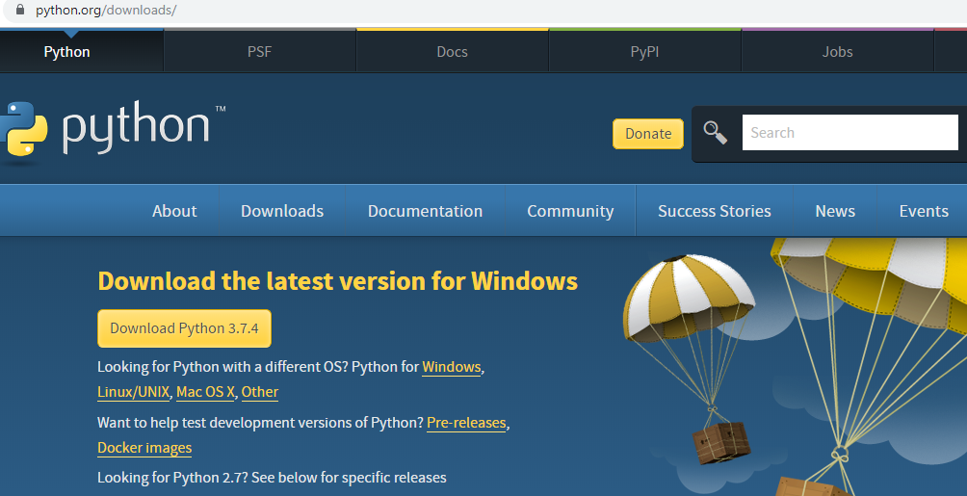
Python

Slide 5
Understanding Python Programming Constructs Basics (Variables, data types, I/O) Operators Lists Tuples Sets Dictionaries Decision Control Structures Repeating Control Structures Functions

Slide 6
Program Steps or Program Flow
Like a recipe or installation instructions, a program is a sequence of steps to be done in order.
Some steps are conditional - they may be skipped.
Sometimes a step or group of steps are to be repeated.
Sometimes we store a set of steps to be used over and over

Slide 7
Comments
Anything after a # symbol is treated as a comment
This is just like Perl
Since Python will ignore string literals that are not assigned to a variable, you can add a multiline string (triple quotes) in your code, and place you comment inside it:
Example
""" This is a comment written in more than just one line """ print("Hello, World!")

Slide 8
Python Indentation Indentation refers to the spaces at the beginning of a code line. Where in other programming languages the indentation in code is for readability only, the indentation in Python is very important. Python uses indentation to indicate a block of code. Example if 5 > 2: print("Five is greater than two!")

Slide 9
Example Syntax Error:
if 5 > 2: print("Five is greater than two!")
The number of spaces is up to you as a programmer, but it has to be at least one.
if 5 > 2: print("Five is greater than two!") if 5 > 2: print("Five is greater than two!")

Slide 10
elif statement
Equivalent of “else if” in C
Example elif.py:
x = 3 if (x == 1): print "one" elif (x == 2): print "two" else: print "many"

Slide 11
Iteration
while loops
for loops
range function
Flow control within loops: break, continue, pass, and the “loop else”

Slide 12
while
Example while.py i=1 while i < 4: print i
i += 1 Output: 1 2 3

Slide 13
for
Example for.py for i in range(3): print i, output: 0, 1, 2
range(n) returns a list of integers from 0 to n-1. range(0,10,2) returns a list 0, 2, 4, 6, 8

Slide 14
Flow control within loops
General structure of a loop: while <statement> (or for <item> in <object>): <statements within loop> if <test1>: break # exit loop now if <test2>: continue # go to top of loop now if <test3>: pass # does nothing! else: <other statements> # if exited loop without # hitting a break

Slide 15
Using the “loop else”
An else statement after a loop is useful for taking care of a case where an item isn't found in a list. Example: search_items.py: for i in range(3): if i == 4: print "I found 4!" break else: print "Don't care about",i

Slide 16
Parallel traversals
If we want to go through 2 lists (more later) in parallel, can use zip: A = [1, 2, 3] B = [4, 5, 6] for (a,b) in zip(A,B): print a, “*”, b, “=”, a*b output: 1 * 4 = 4 2 * 5 = 10 3 * 6 = 18

Slide 17
Escape sequences
Escape Meaning
\\ \
\' '
\” “
\n newline
\t tab

Slide 18
replace method
Doesn't really replace (strings are immutable) but makes a new string with the replacement performed: >>> a = “abcdefg” >>> b = a.replace('c', 'C') >>> b abCdefg >>> a abcdefg

Slide 19
Length of collections
len() returns the length of a tuple, list, or dictionary (or the number of characters of a string):
>>>len((“Tony”,)) 1
>>>len(“Tony”) 4
>>>len([0, 1, 'boom']) 3

Slide 20
Built-in Functions
Several useful built-in functions. Example math.py print pow(2,3)
print abs(-14)
print max(1,-5,3,0) Output: 8 14 3

Slide 21
Sequential Steps
x = 2
Program:
Output:
print x
x = 2 print x x = x + 2 print x
2
4
x = x + 2
print x

Slide 22
Conditional Steps
x = 5
Yes
x < 10 ?
Program:
Output:
x = 5
print 'Smaller'
if x < 10:
print 'Smaller’ if x > 20:
print 'Bigger'
Smaller Finis
x > 20 ?
No
print 'Bigger'
print 'Finis'
print 'Finis'

Slide 23
Repeated Steps
n = 5
No
Yes
Output:
n > 0 ?
Program:
print n
5
4
3
2
1
Blastoff!
n = 5
while n > 0 : print n
n = n – 1 print 'Blastoff!'
n = n -1
print 'Blastoff'
Loops (repeated steps) have iteration variables that change each time through a loop. Often these iteration variables go through a sequence of numbers.

Slide 24
Variables, Expressions, and Statements

Slide 25
Constants
Fixed values such as numbers, letters, and strings are called
“constants” because their value does not change
Numeric constants are as you expect
String constants use single quotes (') or double quotes (")
>>> print 123
123
>>> print 98.6
98.6
>>> print 'Hello world' Hello world

Slide 26
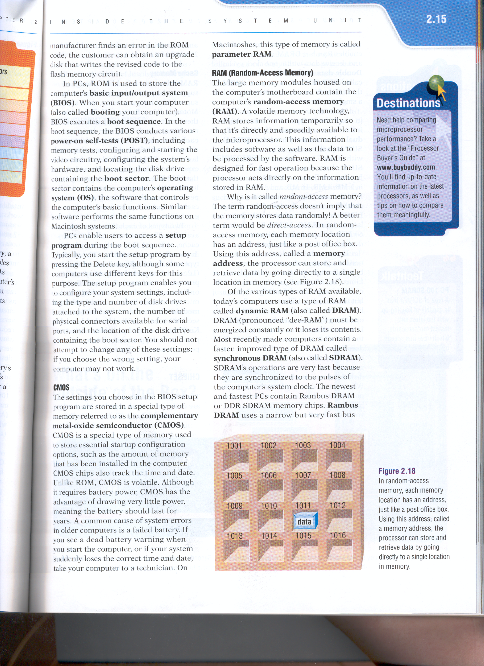
Variables
A variable is a named place in the memory where a programmer can store data and later retrieve the data using the variable “name”
Programmers get to choose the names of the variables
You can change the contents of a variable in a later statement
x = 12.2
y = 14
x
12.2
y
14

Slide 27
Variables
A variable is a named place in the memory where a programmer can store data and later retrieve the data using the variable “name”
Programmers get to choose the names of the variables
You can change the contents of a variable in a later statement
x = 12.2
y = 14
x = 100
x
12.2
100
y
14

Slide 28
Python Variable Name Rules
Must start with a letter or underscore _
Must consist of letters and numbers and underscores
Case Sensitive
Good: spam eggs spam23 _speed
Bad: 23spam @sign var.12
Different: spam Spam SPAM

Slide 29
Reserved Words
You cannot use reserved words as variable names / identifiers
and del for is raise assert elif from lambda return break else global not try class except if or while continue exec import pass yield def ﬁnally in print as with

Slide 30
Sentences or Lines
x = 2
Assignment statement Assignment with expression Print statement
x = x + 2
print x
Variable
Operator
Constant
Reserved Word

Slide 31
Assignment Statements
We assign a value to a variable using the assignment statement (=)
An assignment statement consists of an expression on the right-hand side and a variable to store the result
x = 3.9 * x * ( 1 - x )

Slide 32
Numeric Expressions
>>> xx = 2
>>> xx = xx + 2
>>> print xx 4
>>> yy = 440 * 12
>>> print yy 5280
>>> zz = yy / 1000
>>> print zz 5
>>> jj = 23
>>> kk = jj % 5
>>> print kk 3
>>> print 4 ** 3
64
Operator | Operation
+ | Addition
- | Subtraction
* | Multiplication
/ | Division
** | Power
% | Remainder
4 R 3
5 23
20
3

Slide 33
Operator Precedence Rules
Highest precedence rule to lowest precedence rule:
> Parenthesis are always respected
> Exponentiation (raise to a power)
Parenthesis Power Multiplication Addition
Left to Right
> Multiplication, Division, and Remainder
> Addition and Subtraction
> Left to right

Slide 34
What does “Type” Mean?
In Python variables, literals and constants have a “type”
>>> ddd = 1 + 4
Python knows the difference between an integer number and a string
For example “+” means “addition” if something is a number and “concatenate” if something is a string
>>> print ddd 5
>>> eee = (“hello" + "there"
>>> print (eee) hello there
concatenate = put together

Slide 35
Type Matters
>>> eee = 'hello ' + 'there'
>>> eee = eee + 1
Traceback (most recent call last): File "<stdin>", line 1, in
<module>
TypeError: cannot concatenate 'str' and 'int' objects
>>> type(eee)
<type 'str'>
>>> type('hello')
<type 'str'>
>>> type(1)
<type 'int'>
>>>
Python knows what “type”
everything is
Some operations are prohibited
You cannot “add 1” to a string
We can ask Python what type something is by using the type() function

Slide 36
Several Types of Numbers
Numbers have two main types
> Integers are whole numbers:
-14, -2, 0, 1, 100, 401233
> Floating Point Numbers have decimal parts: -2.5 , 0.0, 98.6, 14.0
There are other number types - they are variations on float and integer
>>> xx = 1
>>> type (xx)
<type 'int'>
>>> temp = 98.6
>>> type(temp)
<type 'float'>
>>> type(1)
<type 'int'>
>>> type(1.0)
<type 'float'>
>>>

Slide 37
Type Conversions
When you put an integer and floating point in an expression, the integer is implicitly converted to a float
You can control this with the built-in functions int() and float()
>>> print float(99) / 100 0.99
>>> i = 42
>>> type(i)
<type 'int'>
>>> f = float(i)
>>> print f 42.0
>>> type(f)
<type 'float'>
>>> print 1 + 2 * float(3) / 4 - 5
-2.5
>>>

Slide 38
User Input
We can instruct Python to pause and read data from the user using the raw_input() function
nam = raw_input('Who are you?') print 'Welcome', nam
The raw_input() function returns a string
Who are you? Chuck Welcome Chuck

Slide 39
String Operations
Some operators apply to strings
> + implies “concatenation”
> * implies “multiple concatenation”
Python knows when it is dealing with a string or a number and behaves appropriately
>>> print 'abc' + '123’ abc123
>>> print 'Hi' * 5 HiHiHiHiHi
>>>

Slide 40
Conditional Execution

Slide 41
Conditional Steps
x = 5
Yes
X < 10 ?
Program:
No
print 'Smaller'
x = 5
if x < 10:
print 'Smaller’
Output:
Yes
Smaller Finis
X > 20 ?
if x > 20:
print 'Bigger'
No
print 'Bigger'
print 'Finis'
print 'Finis'

Slide 42
Comparison Operators
x = 5
if x == 5 :
print 'Equals 5' if x > 4 :
print 'Greater than 4' if x >= 5 :
print 'Greater than or Equals 5' if x < 6 : print 'Less than 6'
if x <= 5 :
print 'Less than or Equals 5' if x != 6 :
print 'Not equal 6'
Equals 5
Greater than 4
Greater than or Equals 5 Less than 6
Less than or Equals 5 Not equal 6

Slide 43
One-Way Decisions
Yes
x = 5
X == 5 ?
print 'Before 5'
Before 5
Is 5
Is Still 5
Third 5 Afterwards 5
Before 6 Afterwards 6
if x == 5 :
print 'Is 5'
print 'Is Still 5' print 'Third 5'
No
print 'Is 5'
print 'Still 5'
print 'Afterwards 5’
print 'Before 6’ if x == 6 :
print 'Is 6'
print 'Is Still 6' print 'Third 6'
print 'Afterwards 6'
print 'Third 5'

Slide 44
Nested Decisions
yes
x > 1
no
print 'More than one'
x = 42
if x > 1 :
print 'More than one' if x < 100 :
print 'Less than 100' print 'All done'
yes
x < 100
no
print 'Less than 100'
print 'All Done'

Slide 45
Two-way Decisions
X = 4
Sometimes we want to do one thing if a logical expression is true and something else if the expression is false
It is like a fork in the road - we must choose one or the other path but not both
no
yes
x > 2
print 'Not bigger'
print 'Bigger'
print 'All Done'

Slide 46
Two-way using else :
x = 4
no
yes
x > 2
x = 4
if x > 2 :
print 'Bigger' else :
print 'Smaller'
print 'Smaller'
print 'Bigger'
print 'All done'
print 'All Done'

Slide 47
Multi-way
x = 0
yes
print 'small'
x < 2
x = 0
if x < 2 :
print 'small' elif x < 10 :
print 'Medium' else :
print 'LARGE' print 'All done'
no
yes
print 'Medium'
x < 10
no
print 'LARGE'
print 'All Done'

Slide 48
Multi-way
x = 5
yes
print 'small'
x < 2
x = 5
if x < 2 :
print 'small' elif x < 10 :
print 'Medium' else :
print 'LARGE' print 'All done'
no
yes
print 'Medium'
x < 10
no
print 'LARGE'
print 'All Done'

Slide 49
Multi-way
x = 20
yes
print 'small'
x < 2
x = 20
if x < 2 :
print 'small' elif x < 10 :
print 'Medium' else :
print 'LARGE' print 'All done'
no
yes
print 'Medium'
x < 10
no
print 'LARGE'
print 'All Done'

Slide 50
Loops and Iteration

Slide 51
Repeated Steps
n = 5
No
Yes
Output:
Program:
5
n > 0 ?
print n
n = 5
while n > 0 :
print n n = n – 1
print 'Blastoff!' print n
4
3
2
1
Blastoff! 0
n = n -1
print 'Blastoff'
Loops (repeated steps) have iteration variables that change each time through a loop. Often these iteration variables go through a sequence of numbers.

Slide 52
An Infinite Loop
n = 5
No
Yes
n > 0 ?
print 'Lather'
n = 5
while n > 0 :
print 'Lather’ print 'Rinse'
print 'Dry off!'
print 'Rinse'
print 'Dry off!'
What is wrong with this loop?

Slide 53
Another Loop
n = 0
No
Yes
n > 0 ?
print 'Lather'
n = 0
while n > 0 :
print 'Lather' print 'Rinse'
print 'Dry off!'
print 'Rinse'
print 'Dry off!'
What does this loop do?

Slide 54
Breaking Out of a Loop
The break statement ends the current loop and jumps to the statement immediately following the loop
It is like a loop test that can happen anywhere in the body of the loop
> hello there
while True:
line = raw_input('> ') if line == 'done' :
break print line
print 'Done!'
hello there
> finished finished
> done Done!

Slide 55
Breaking Out of a Loop
The break statement ends the current loop and jumps to the statement immediately following the loop
It is like a loop test that can happen anywhere in the body of the loop
> hello there
while True:
line = raw_input('> ') if line == 'done' :
break print line
print 'Done!'
hello there
> finished finished
> done Done!

Slide 56
No
Yes
while True:
line = raw_input('> ') if line == 'done' :
break print line
print 'Done!'
True ?
....
break
...
print 'Done'

Slide 57
Finishing an Iteration with continue
The continue statement ends the current iteration and jumps to the top of the loop and starts the next iteration
while True:
line = raw_input('> ') if line[0] == '#' :
continue
if line == 'done' : break
print line print 'Done!'
> hello there hello there
> # don't print this
> print this! print this!
> done Done!

Slide 58
Indefinite Loops
While loops are called “indefinite loops” because they keep going until a logical condition becomes False
The loops we have seen so far are pretty easy to examine to see if they will terminate or if they will be “infinite loops”
Sometimes it is a little harder to be sure if a loop will terminate

Slide 59
Definite Loops
Quite often we have a list of items of the lines in a file - effectively a finite set of things
We can write a loop to run the loop once for each of the items in a set using the Python for construct
These loops are called “definite loops” because they execute an exact number of times
We say that “definite loops iterate through the members of a set”

Slide 60
A Simple Definite Loop
5
4
3
2
1
Blastoff!
for i in [5, 4, 3, 2, 1] : print i
print 'Blastoff!'

Slide 61
A Simple Definite Loop
Yes
No
Done?
Move i ahead
5
4
3
2
1
Blastoff!
for | i in | [5, | 4, | 3, | 2, | 1] :
 | print | i
print i
print 'Blastoff!'
print 'Blast off!'
Definite loops (for loops) have explicit iteration variables that change each time through a loop. These iteration variables move through the sequence or set.

Slide 62
print i
i = 5
No
Yes
Done?
Move i ahead
i = 4
print i
print i
i = 3
print i
i = 2
for i in [5, 4, 3, 2, 1] : print i
print i
i = 1
print i

Slide 63
Looping through a Set
print 'Before'
for thing in [9, 41, 12, 3, 74, 15] : print thing
print 'After'
$ python basicloop. py
Before 9
41
12
3
74
15
After

Slide 64
What is the Largest Number?
3 41 12 9 74 15

Slide 65
What is the Largest Number?
-1
largest_so_far

Slide 66
What is the Largest Number?
3
3
largest_so_far

Slide 67
What is the Largest Number?
41
41
largest_so_far

Slide 68
What is the Largest Number?
12
41
largest_so_far

Slide 69
What is the Largest Number?
9
41
largest_so_far

Slide 70
What is the Largest Number?
74
74
largest_so_far

Slide 71
What is the Largest Number?
15
74
largest_so_far

Slide 72
What is the Largest Number?
3 41 12 9 74 15
74
largest_so_far

Slide 73
Finding the largest value
$ python largest.py
largest_so_far = -1
print 'Before', largest_so_far
for the_num in [9, 41, 12, 3, 74, 15] :
if the_num > largest_so_far :
largest_so_far = the_num
print largest_so_far, the_num
Before -1
9 9
41 41
41 12
41 3
74 74
74 15
After 74
print 'After', largest_so_far
We make a variable that contains the largest value we have seen so far. If the current number we are looking at is larger, it is the new largest value we have seen so far.

Slide 74
Counting in a Loop
$ python countloop.py
zork = 0
print 'Before', zork
for thing in [9, 41, 12, 3, 74, 15] : zork = zork + 1
print zork, thing print 'After', zork
Before 0
1 9
2 41
3 12
4 3
5 74
6 15
After 6
To count how many times we execute a loop, we introduce a counter variable that starts at 0 and we add one to it each time through the loop.

Slide 75
Summing in a Loop
$ python countloop.py
zork = 0
print 'Before', zork
for thing in [9, 41, 12, 3, 74, 15] : zork = zork + thing
print zork, thing print 'After', zork
Before 0
9 9
50 41
62 12
65 3
139 74
154 15
After 154
To add up a value we encounter in a loop, we introduce a sum variable that starts at 0 and we add the value to the sum each time through the loop.

Slide 76
Finding the Average in a Loop
$ python averageloop.py
count = 0
sum = 0
Before 0 0
1 9 9
2 50 41
3 62 12
4 65 3
5 139 74
6 154 15
After
6 154 25
print 'Before', count, sum
for value in [9, 41, 12, 3, 74, 15] : count = count + 1
sum = sum + value print count, sum, value
print 'After', count, sum, sum / count
An average just combines the counting and sum patterns and divides when the loop is done.

Slide 77
Filtering in a Loop
print 'Before'
for value in [9, 41, 12, 3, 74, 15] : if value > 20:
print 'Large number',value print 'After'
$ python search1.py Before
Large number 41
Large number 74 After
We use an if statement in the loop to catch / filter the values we are looking for.

Slide 78
Search Using a Boolean Variable
$ python search1.py Before False
found = False
print 'Before', found
for value in [9, 41, 12, 3, 74, 15] : if value == 3 :
found = True print found, value
print 'After', found
False 9
False 41
False 12
True 3
True 74
True 15 After True
If we just want to search and know if a value was found, we use a variable that starts at False and is set to True as soon as we find what we are looking for.

Slide 79
Finding the largest value
$ python largest.py
largest_so_far = -1
print 'Before', largest_so_far
for the_num in [9, 41, 12, 3, 74, 15] :
if the_num > largest_so_far :
largest_so_far = the_num
print largest_so_far, the_num
Before -1
9 9
41 41
41 12
41 3
74 74
74 15
After 74
print 'After', largest_so_far
We make a variable that contains the largest value we have seen so far. If the current number we are looking at is larger, it is the new largest value we have seen so far.

Slide 80
Finding the smallest value
smallest_so_far = -1
print 'Before', smallest_so_far
for the_num in [9, 41, 12, 3, 74, 15] :
if the_num < smallest_so_far :
smallest_so_far = the_num print
smallest_so_far, the_num
print 'After', smallest_so_far
We switch the variable name to smallest_so_far and switch the > to <

Slide 81
Finding the smallest value
smallest = None print 'Before'
for value in [9, 41, 12, 3, 74, 15] : if smallest is None :
smallest = value elif value < smallest :
smallest = value print smallest, value
print 'After', smallest
$ python smallest.py Before
9 9
9 41
9 12
3 3
3 74
3 15
After 3
We still have a variable that is the smallest so far. The first time through the loop smallest is None, so we take the first value to be the smallest.

Slide 82
References /Acknowledgements
Courtesy to:
Initial Development: Charles Severance, University of Michigan School of Information
MIT University resources
Several latest Anonyms Internet resources
Several Books consultant
Self contribution and experience
https://www.python.org/
Anonyms resources including Internet, Books, Lectures, Videos, Blogs.
VS Code IDLE
Q & A

